Slide 1
Platys –Provisioning of modern data platforms simplified!
Guido Schmutz, Ulises Fasoli
gschmutz
http://guidoschmutz.wordpress.com

Slide 2
Agenda
Motivation for Platys
Installing Platys
Platys in Action

Slide 3
Motivation for Platys?

Slide 4
Requirements for a Platform for Lab, PoC and PoV projects
For Labs, PoC and PoV projects as well as trainings we wanted a platform
which is easy to deploy
supports modular, extensible and configurable set of services
where new services can be added quickly and tested as part of an existing platform (set of services)
where no infrastructure specialist is needed for provisioning
lightweight, low footprint (resources needed)
simple, lightweight transportation
runs on-premises and in the cloud

Slide 5
Platform for Lab, PoC and PoV projects
 |  | Bare Metal | VM | Cloud PaaS | Docker & Docker Compose
1 | Easy Deployment | + | ++ | +++ | +++
2 | Modular, extensible | ++ | ++ | ++ | +++
3 | Add new services quickly | + | + | ++ (1) | +++
4 | No infrastructre specialist needed | + | ++ | +++ | +++
5 | Lightweight footprint | + | ++ | + | +++
6 | Simple, lightweight transportation | - | + | ++ (2) | +++
7 | On prem & cloud | + | +++ | ++ | +++ (3)
If exists as PaaS
Within same cloud provider
Runs anywhere Docker & Docker Compose runs
Notes:
which is easy to deploy
Supports modular, extensible and configurable set of services
Quickly add new services and test them as part of an existing platform (set of services)
no infrastructure specialist needed for provisioning
lightweight, low footprint (resources needed)
Simple, lightweight transportation
runs on-premises and in the cloud

Slide 6
What is Docker, what is Docker Compose?
Docker – running a single service
Docker Compose – running a set of services belonging together
docker run -d –p 18630:18630 –e SDC_CONF_MONITOR_MEMORY:true -v sdc-data:/data --name streamsets-dc streamsets/datacollector:3.15.0
docker-compose up -d
streamsets-1:
image: streamsets/datacollector:3.15.0
ports:
- 18630:18630
environment:
SDC_CONF_MONITOR_MEMORY: 'true'
SDC_CONF_PIPELINE_MAX_RUNNERS_COUNT: 50
volumes:
- ./sdc-data:/data
kafka-1:
image: confluentinc/cp-enterprise-kafka:5.5.0
depends_on:
- zookeeper-1
ports:
- 9092:9092
...

Slide 7
platys – Trivadis Platform in a Box
open-source toolset, developed by the Trivadis Platform Factory
help provisioning Modern Data Platforms based on Docker and Docker Compose
its main use is for small-scale Data Lab projects, Proof-of-Concepts (PoC) or Proof-of-value (PoV) projects as well as trainings
See here for how to install platys
https://github.com/TrivadisPF/platys

Slide 8
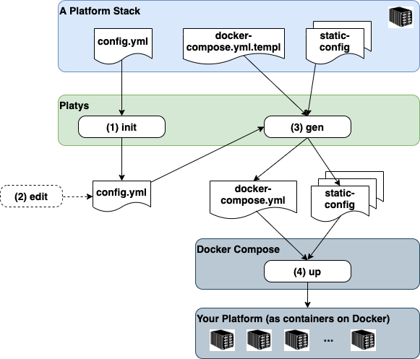
Trivadis platys – Platform in a Box
Platform Stack
A given set of services to choose from
A generator for generating a set of these services as a Platform
Platform
An instance of a set of services generated based on a Platform Stack
Fully runnable platform based on Docker Compose and Docker
Platys
The CLI tool to control the Platform Stack

Slide 9
Installing Platys

Slide 10
Trivadis platys – How to install? (I)
Platys runs on Linux, Mac OS-X and Windows
Installation is comparable to installing docker-compose, on Ubuntu perform the following steps
Download the binary
Untar and move it to /usr/local/bin
sudo curl -L "https://github.com/TrivadisPF/platys/releases/download/2.2.0/platys.tar.gz" -o /tmp/platys.tar.gz
tar zvxf /tmp/platys.tar.gz
sudo mv platys.dist/ /usr/local/lib/
sudo chown -R root:root /usr/local/lib/platys.dist/
sudo rm /tmp/platys.tar.gz

Slide 11
Trivadis platys – How to install? (II)
Download the binary
Use the --version option to check that the generator has been installed successfully
sudo ln -s /usr/local/lib/platys.dist/platys /usr/local/bin/platys
$ platys --version
Platys - Trivadis Platform in a Box - v2.2.0

Slide 12
Platys in Action

Slide 13
Trivadis platys – Platform in a Box
Steps for working with platys
Init a platform based on a given platform stack
Edit the config.yml files to enable services needed
Generate the docker-compose platform
Start the platform

Slide 14
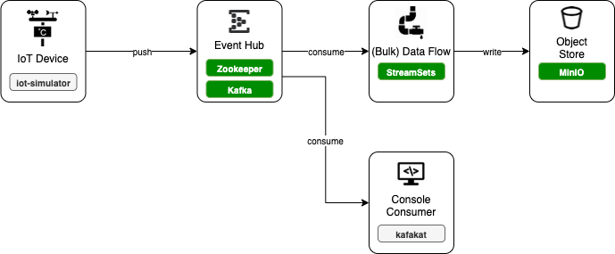
Trivadis platys – How does it work? (I)
Let’s see Platys in Action by generating a simple Platform with the following service

Slide 15
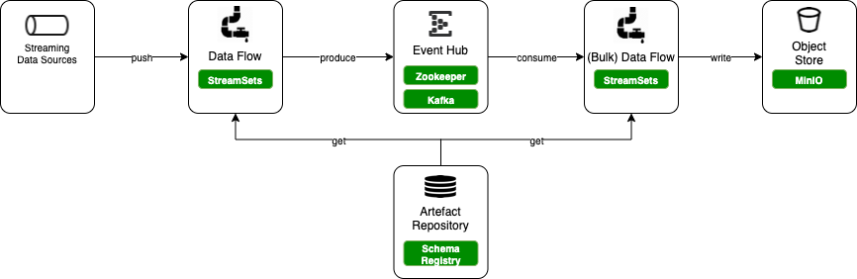
Trivadis platys – How does it work? (I)
Let’s see Platys in Action by generating a simple Platform with the following service

Slide 16
Trivadis platys – How does it work? (II)
Create a folder as your platform working directory
Initialize the platform using the platys init command
A config.yml file is created locally, holding all the possible options of the modern-data-platform 1.5.0 stack. See here for a documentation of the various options.
mkdir platys-demo
dd platys-demo
platys init -n platys-demo-platform -sn trivadis/platys-modern-data-platform -sv 1.5.0

Slide 17
Trivadis platys – How does it work? (III)
Use an editor to set the needed services to true.
# Default values for the generator
# this file can be used as a template for a custom configuration
# or to know about the different variables available for the generator
platys:
platform-name: ‘platys-demo'
stack-image-name: 'trivadis/platys-modern-data-platform'
stack-image-version: ‘1.5.0’
structure: ‘flat’
# ===== Apache Zookeeper ========
KAFKA_enable: true
# one of enterprise, community
KAFKA_edition: 'community'
KAFKA_volume_map_data: false
KAFKA_broker_nodes: 3
KAFKA_delete_topic_enable: false
KAFKA_auto_create_topics_enable: false

Slide 18
Trivadis platys – How does it work? (IV)
Run platys gen to generate your platform
All the necessary artefacts for the Docker Compose platform have been generated and are ready to be started
Start the platform using docker-compose up
platys gen
docker-compose up -d

Slide 19
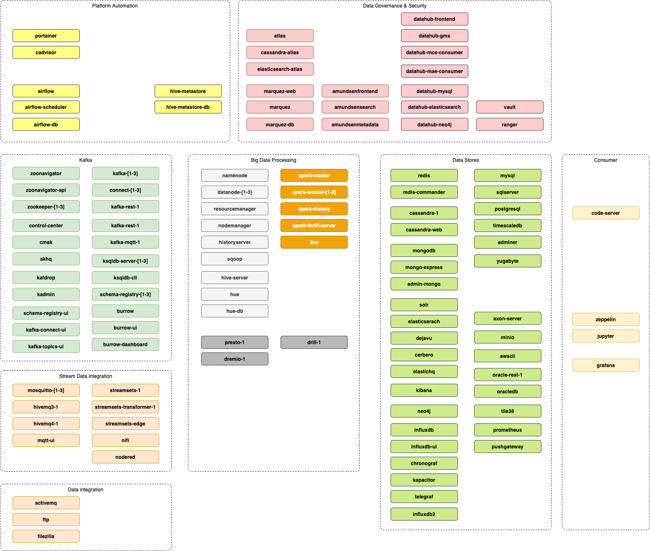
modern-data-platform V1.5
These are the services the curent platform supports
Check the Configuration documentation for how to use

Slide 20
What else?
docker-compose.override.yml for adding / re-configuring things not (yet) covered by platys
-s flag for directly creating a valid config.yml
Cookbooks will be made available showing various aspects of the modern data platform
Multiple platforms in one box ;-) => ARM and x86-64
other platform can be added by replicating what has been done for the modern data platform (docker container)
Slack channel will come
We are hiring :-)

Slide 21
Structure: Flat vs. Subfolder
Flat
platys-demo
├── config.yml
├── docker-compose.yml
├── conf
├── container-volume
├── data-transfer
├── init
├── plugins
└── scripts
Subfolder
platys-demo
├── config.yml
└── my-platform
├── conf
├── container-volume
├── data-transfer
├── init
├── plugins
├── scripts
└── docker-compose.yml

Slide 22
Trivadis platys – Tips and Tricks
In the init you can also pass a list of services to directly set to true to omit having to edit the config.yml
You can list the available service of a given platform stack by using the list_services command
platys init -n platys-demo-platform -sn trivadis/platys-modern-data-platform -sv 1.5.0
-f -s KAFKA,SPARK,JUPYTER
platys list_services -sn trivadis/platys-modern-data-platform -sv 1.5.0

